Slide 1
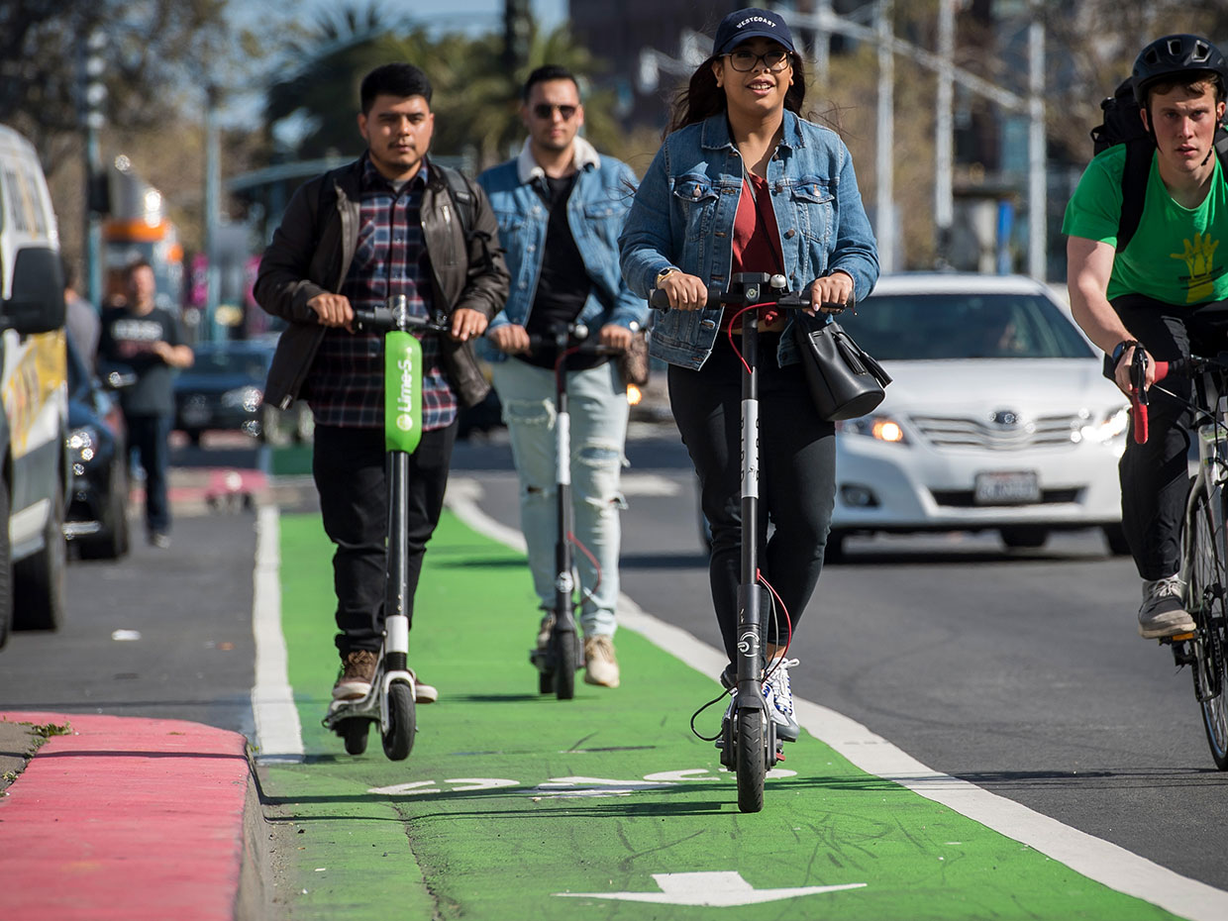

Scooter Rebalance Application
Shared Scooters, as a new type of transportation, brings the convenience of "last mile" to people. However, due to the asymmetry of people's behavior, scooters are redundant or lacking in different areas. Therefore, scooter companies need to determining the number of scooters that need to be rebalanced across the blocks every day.
The current company's approach is not an exact science but rely on experiments. They determines the number of scooters in one block based on whether all scooters were used in this area and whether there was a surplus. This experimental method is inefficient and it is not possible to determine the scooters’ distribution number directly in a new area.

Slide 2
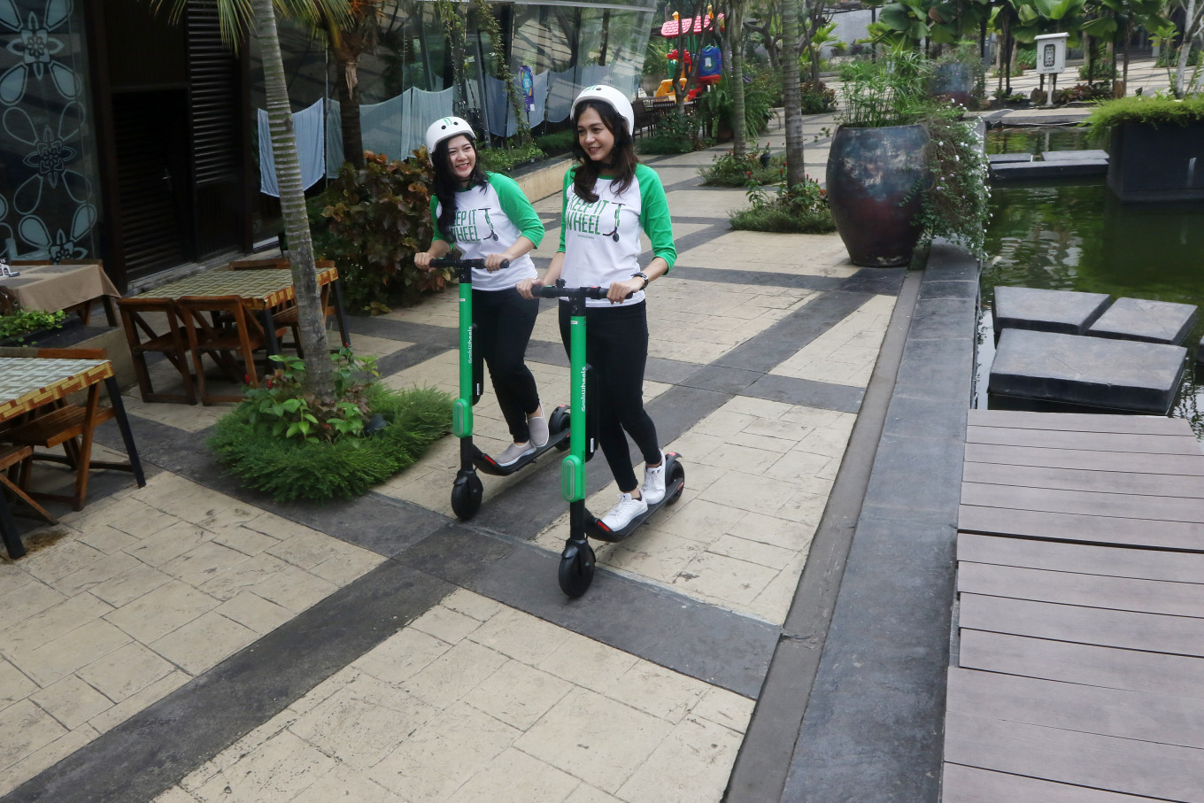
Our Data Driven Approach
Apply the Space-Time model predicting scooters’ start and end in each block. Then calculate the net difference map.
For company, use the map to recommend rebalance amounts among service areas.
For riders, encourage them ride from oversupply areas to short supply areas.

Slide 3
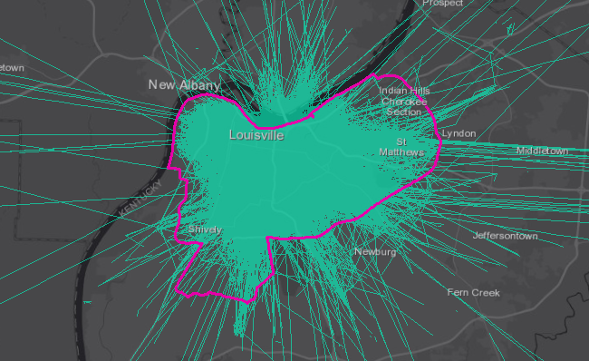
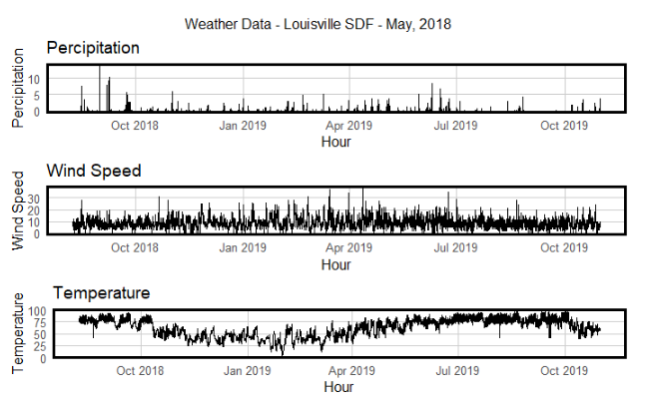
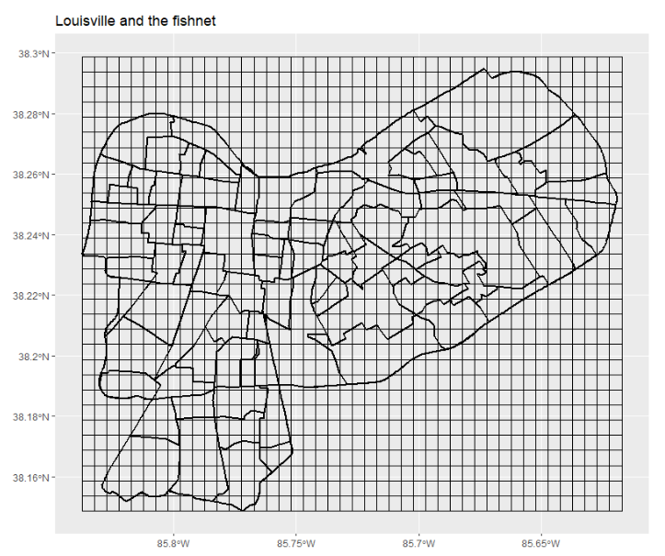

Data Description
Scooter Trip Data
Weather Data
Start Points
End Points
Time
Temperature
Precipitation
Wind Speed
Census Data
Open Street Data
Population
Medium Income
Race
Subway Station
School
Park

Slide 4
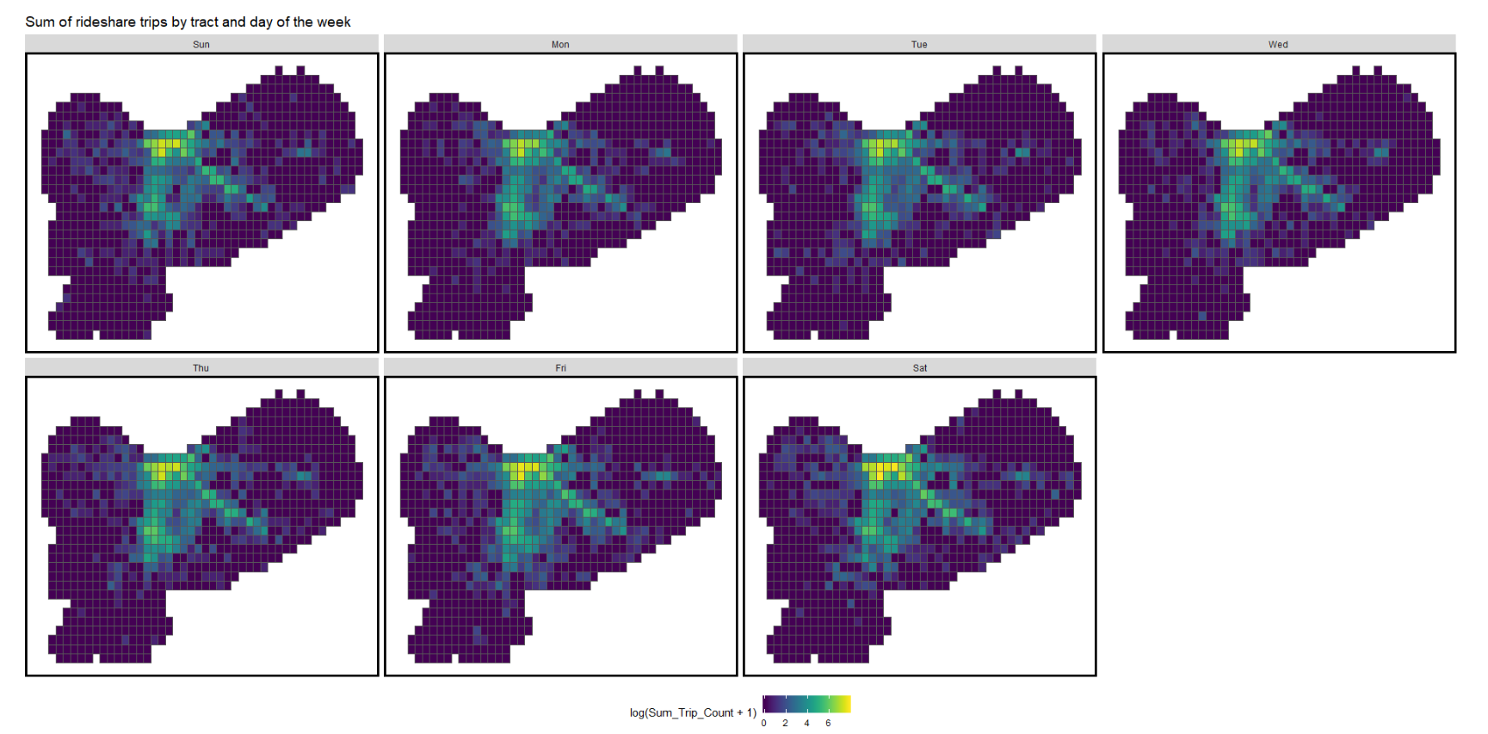
Exploratory Analysis-- Spatial
Sunday
Monday
Tuesday
Wednesday
Thursday
Friday
Saturday
Trips on weekends
More decentralized and broader
than trips on weekdays
Trip Counts of Fishnet by Day of Week (log-transformed)

Slide 5
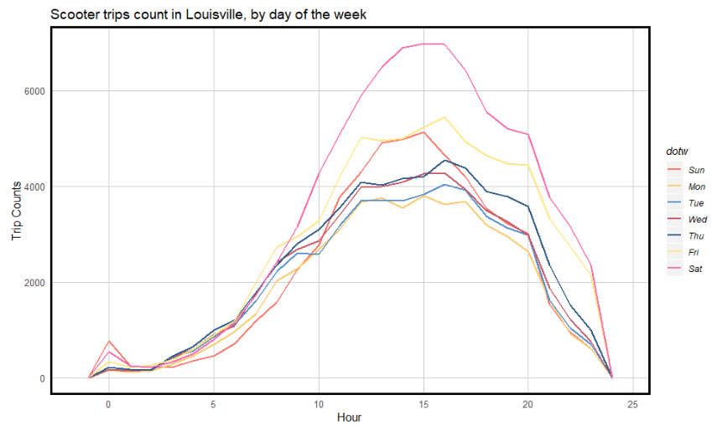
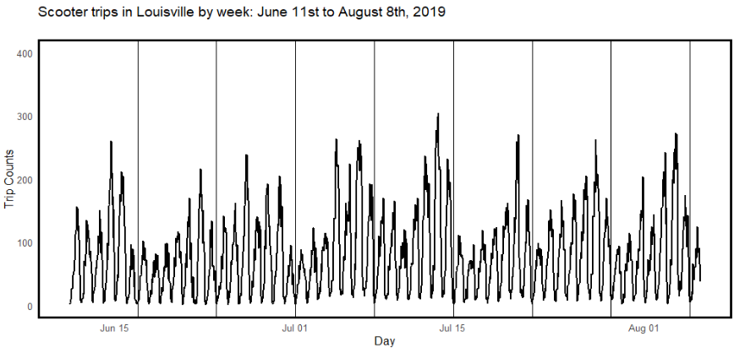
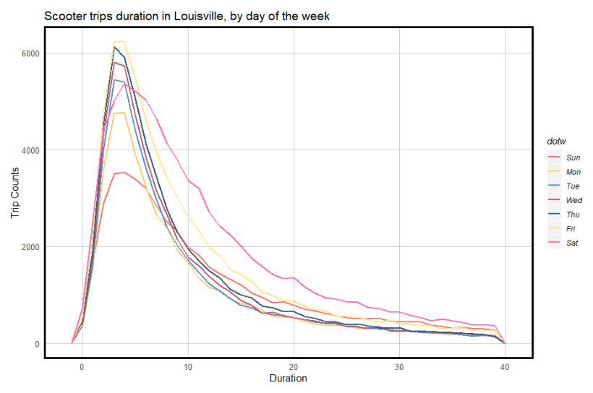
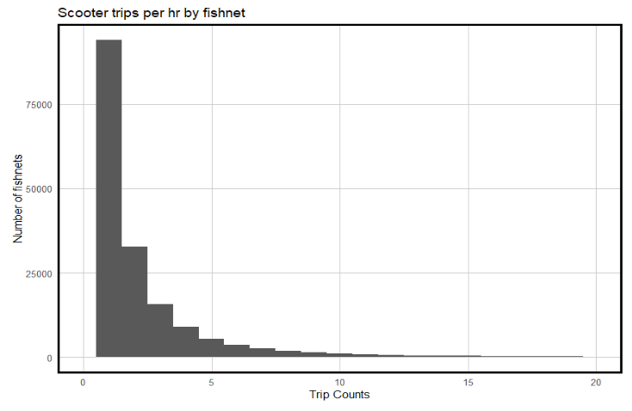
Exploratory Analysis -- Temporal
Detail
Trip counts by day of week
Trips between June and August
Trips by hours and week
Short Time
Trips duration by day of week
Trip counts by fishnet
Long Time
Integrated

Slide 6
Model works in Theory
Features: weather, city facilities, census tracts…
Engineering: N nearest function
900
1000
1 million
Fishnets
Hours
Rows Panel
Spatial lag
Time lag
Space Time Prediction

Slide 7
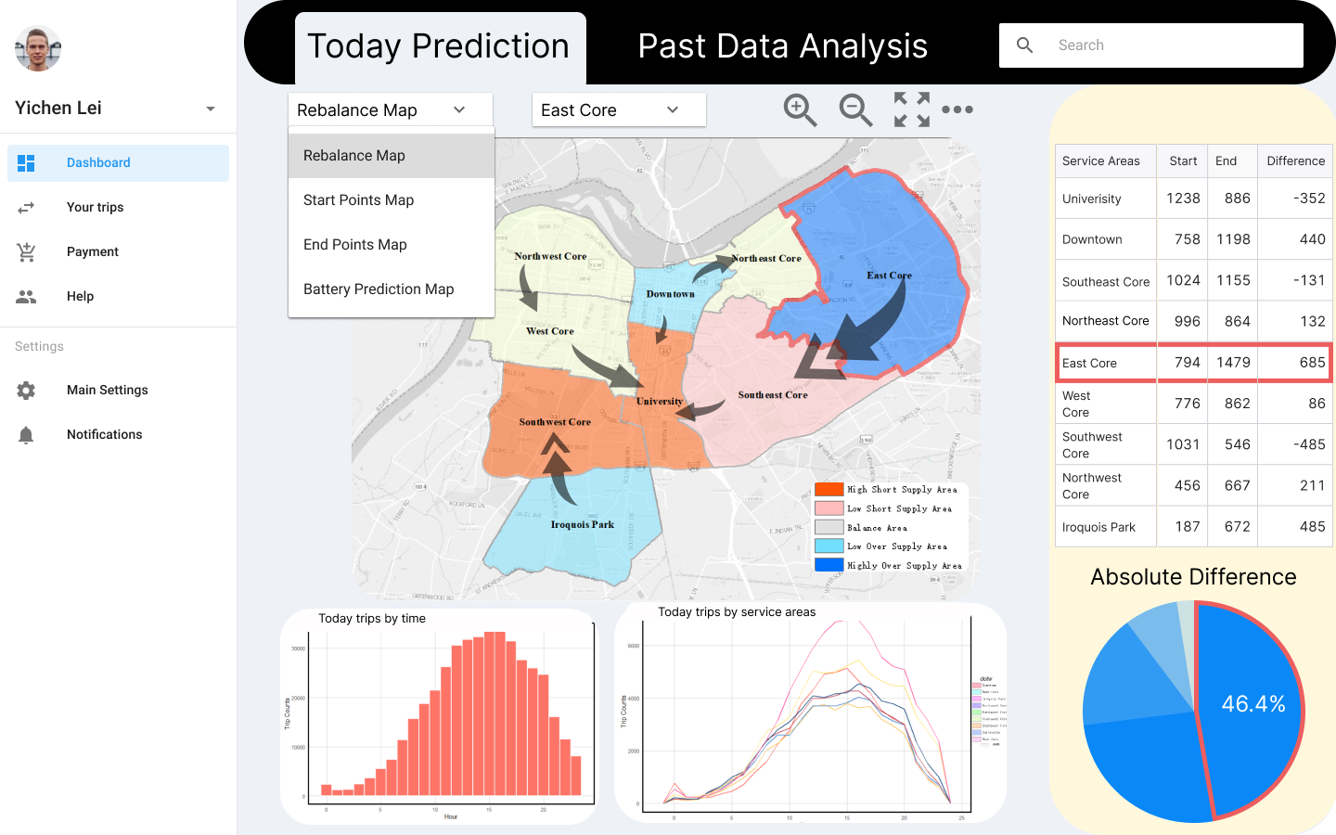
Web APP Wireframe 1

Slide 8
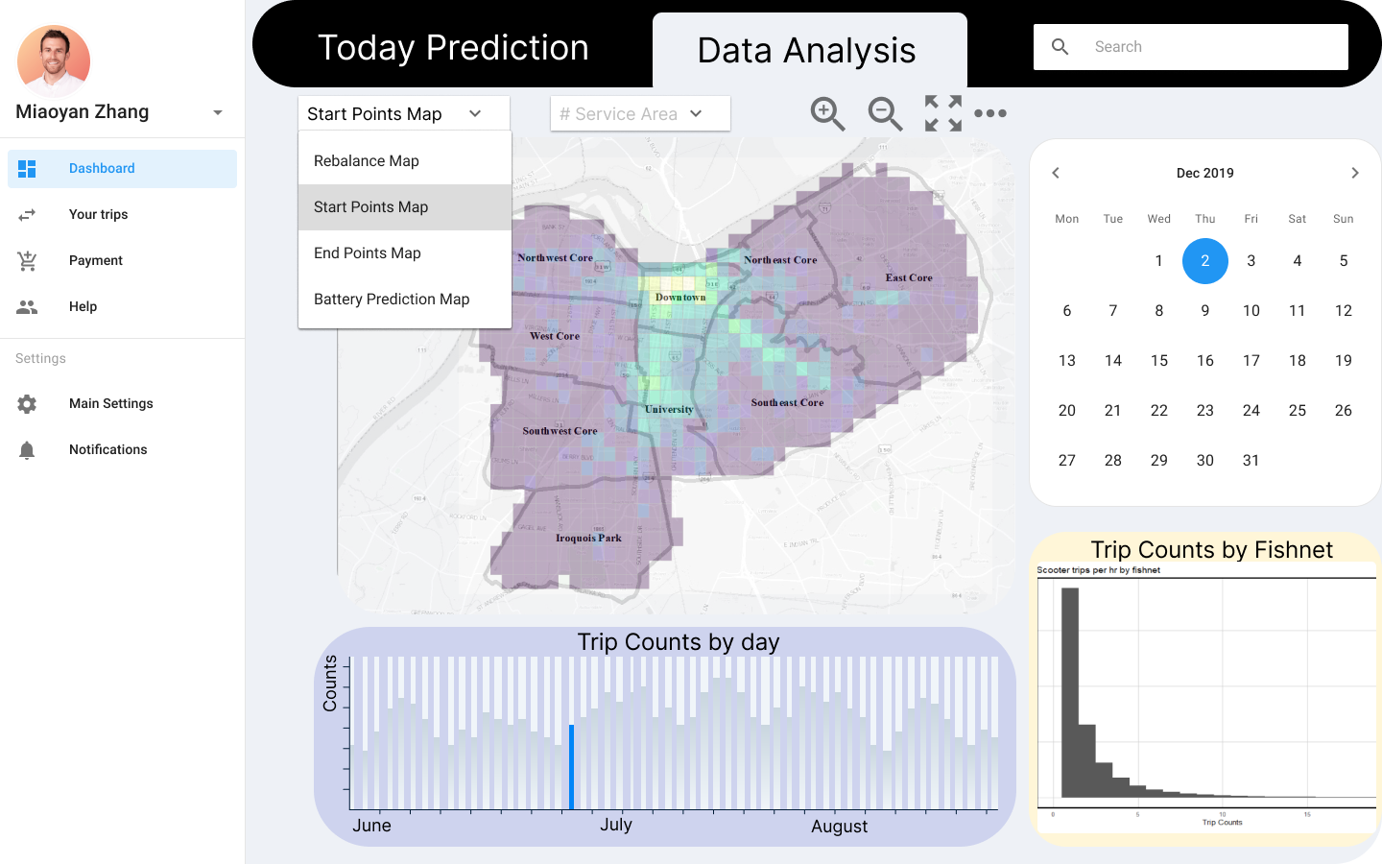
Web APP Wireframe 2

Slide 9
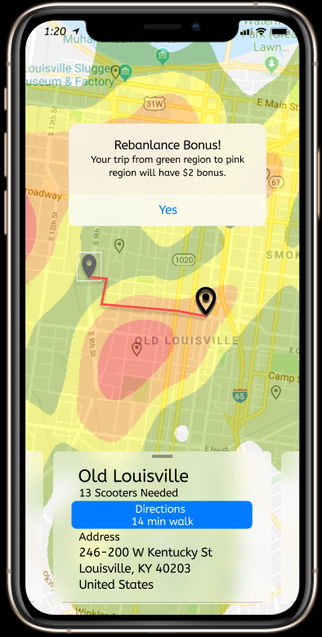
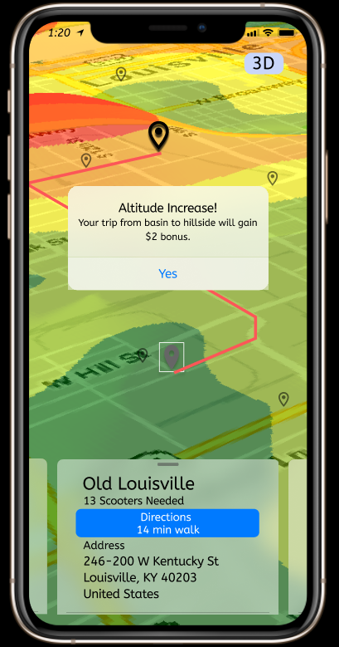
Mobile APP Wireframe— Altitude Concept
Oversupply area (low demand): Low altitude (green)
Short supply area (high demand): High altitude (red)

